Slide 1

Face Recognition attendance System Project
Prepared by Eldho Shaji, Alan Thomas

Slide 2

Introduction
In the landscape of technological advancements, the face recognition attendance system stands as an innovative solution utilizing facial recognition technology for attendance management. This system employs advanced algorithms to analyze and verify unique facial features, offering a secure, contactless, and efficient method for attendance tracking.

Slide 3

Objective
The objective of the face recognition attendance system is to employ facial recognition technology for precise and secure attendance tracking, streamlining the process while ensuring accuracy. This system aims to create a seamless, contactless method for efficient attendance management, reducing manual processes. Additionally, the goal is to evaluate its feasibility and scalability, assessing its adaptability for integration across various environments and industries, thereby laying the foundation for its potential implementation in diverse settings.

Slide 4
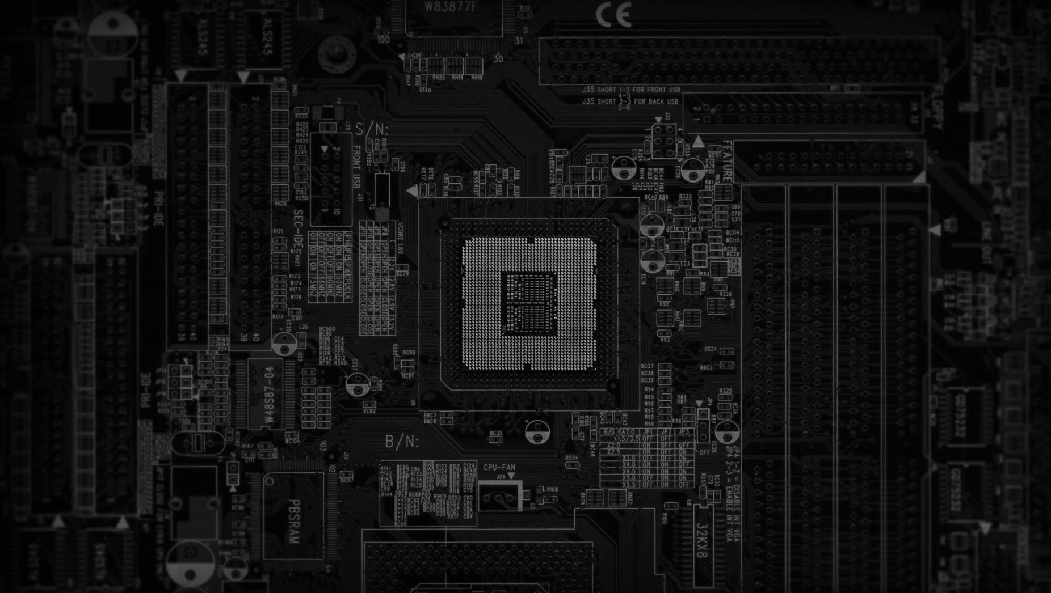
Technical Overview
The face recognition attendance system operates on advanced facial recognition algorithms and machine learning models. Initially, the system captures facial data through a camera or image input. This data is processed to extract unique facial features, which are then encoded into a mathematical representation. Machine learning algorithms compare these representations to a database of stored facial patterns to identify and authenticate individuals. The system utilizes deep learning techniques, such as Convolutional Neural Networks (CNNs), for robust feature extraction and pattern matching, ensuring a high level of accuracy in recognizing individuals. Upon successful recognition, the attendance data is logged into the system, providing an efficient, contactless, and secure method for attendance management.

Slide 5

Modules Used in this Project
Pillow, pandas, opencv, os, tkinder, numpy

Slide 6
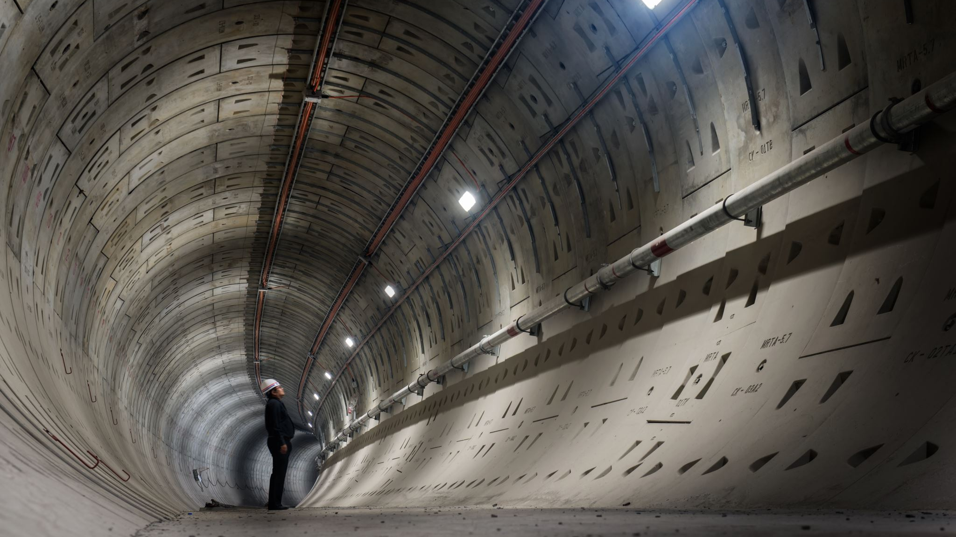
Scope for Future Work
The scope and future work for the face recognition attendance system revolve around refining accuracy in diverse conditions, encompassing varying lighting and angles to ensure consistent and precise attendance tracking. Future efforts will focus on advancing machine learning capabilities to enable real-time facial recognition, prioritizing speed and scalability enhancements. Further exploration involves integrating additional security measures like multi-factor authentication and developing user-friendly interfaces for administrators and end-users. Additionally, the system's potential adaptation in various sectors beyond educational and workplace environments, such as public events, healthcare, and governmental institutions, signifies its broader usability and potential impact, emphasizing the need for ongoing advancements in technology and usability while maintaining a focus on privacy and ethical considerations.

Slide 7

Conclusion
the face recognition attendance system represents a pivotal advancement in attendance monitoring, offering a secure, efficient, and contactless solution across diverse sectors. Its utilization of cutting-edge facial recognition technology not only ensures heightened accuracy and streamlined attendance management but also signifies a significant shift toward modern, convenient tracking methods. The system's potential for further development and integration into various environments underscores its transformative impact on attendance monitoring. However, as this technology evolves, continuous attention to ethical considerations and privacy concerns remains paramount. The face recognition attendance system symbolizes a future where attendance tracking is not only precise and efficient but also adaptable and secure across multifaceted settings.

